Slide 1
CBA 2025 –
A short presentation

Slide 2
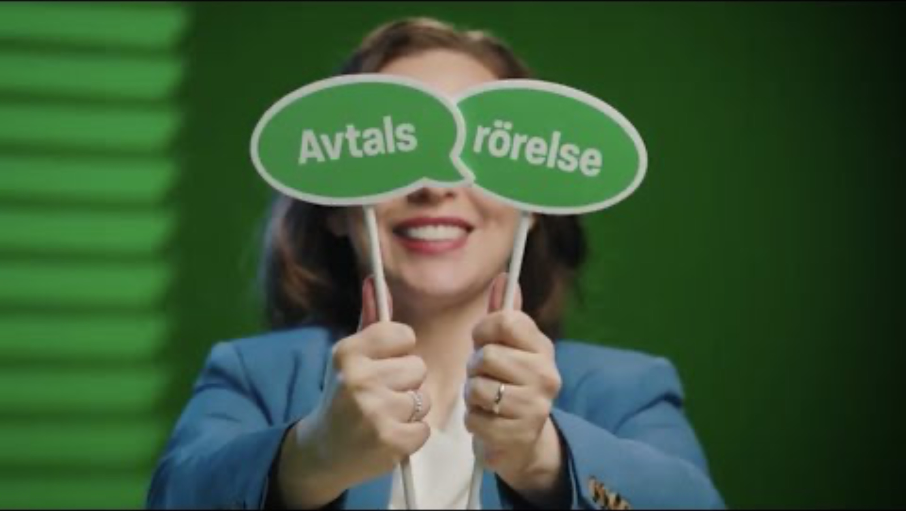
Notes:
Url to film: https://youtu.be/Cajs6FGAt7M

Slide 3
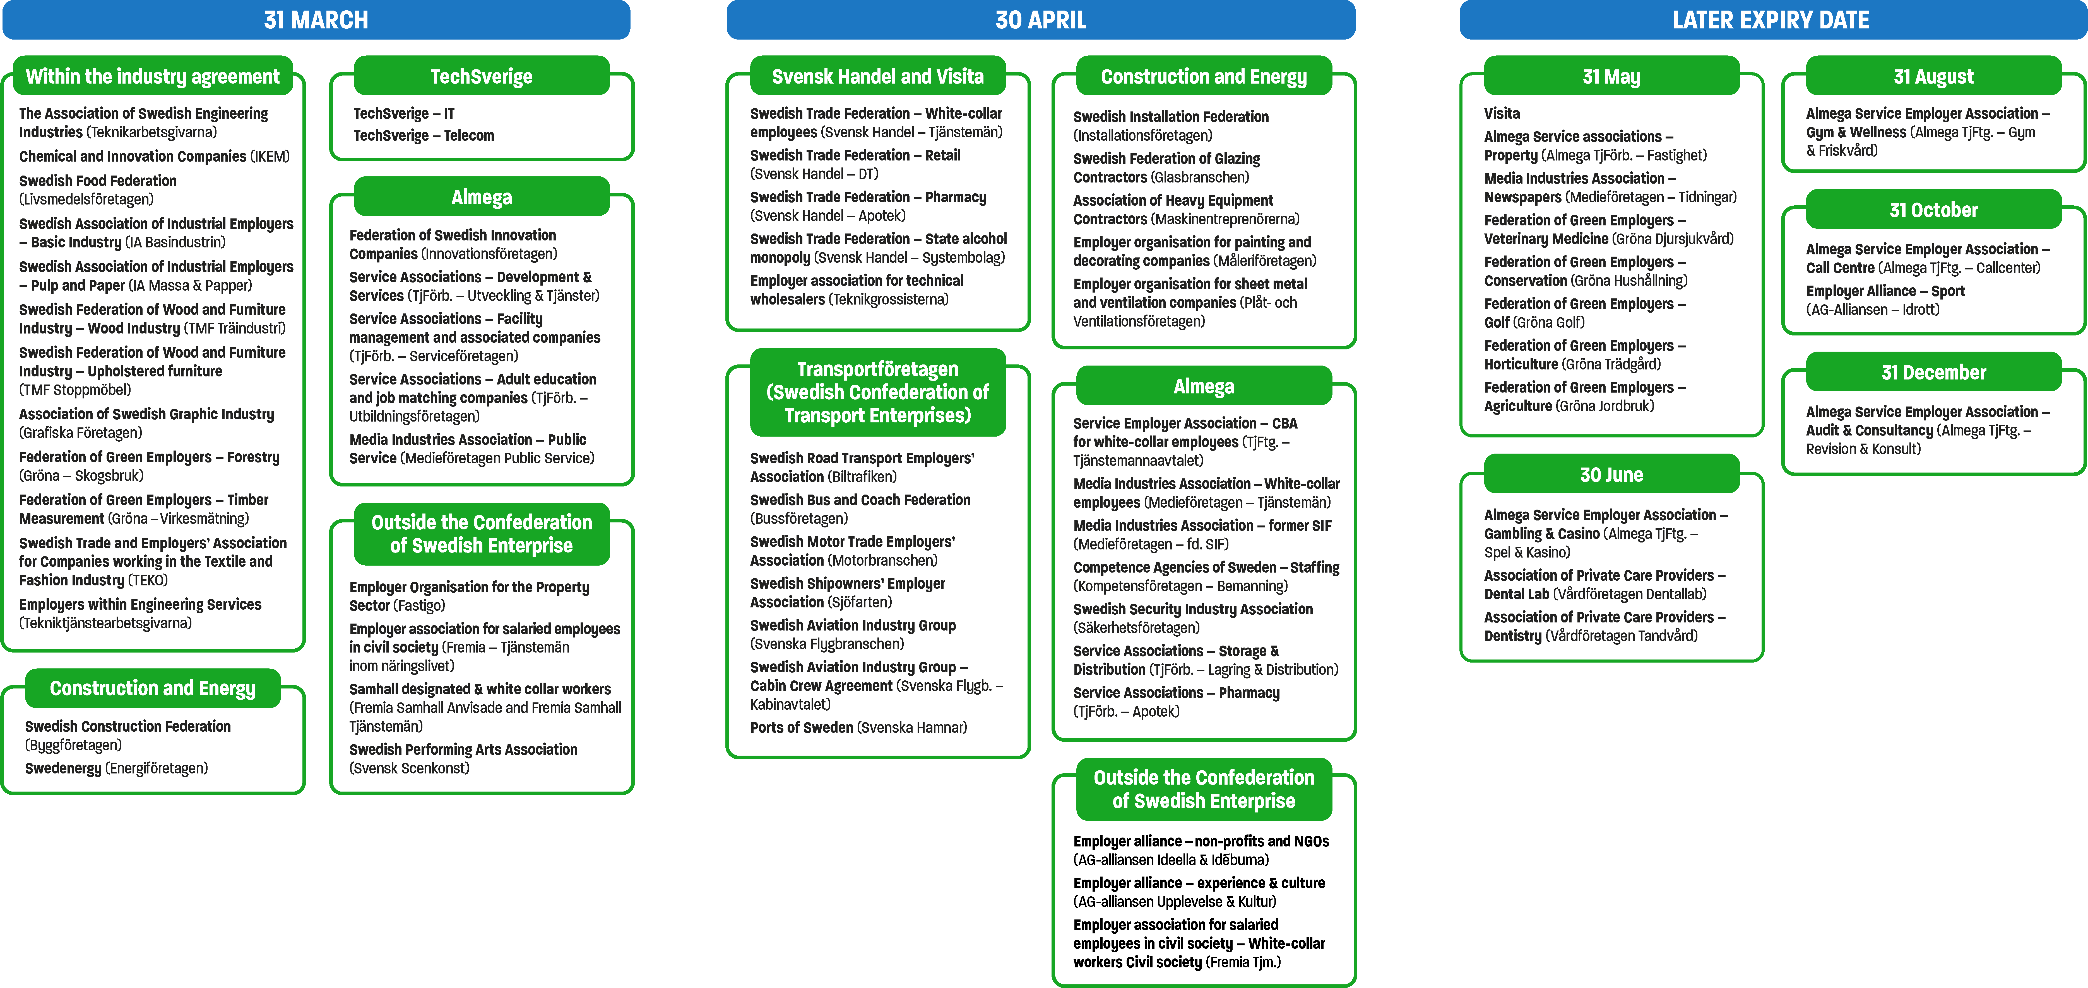

Central agreements to be renegotiated
Current agreements have the following expiry dates in 2025.
Notes:
Here are all the Unionen agreements to be renegotiated in 2025.
NB: Note the star in the bottom right corner – you can, if you wish, drag it to the collective agreement that applies to your company.

Slide 4
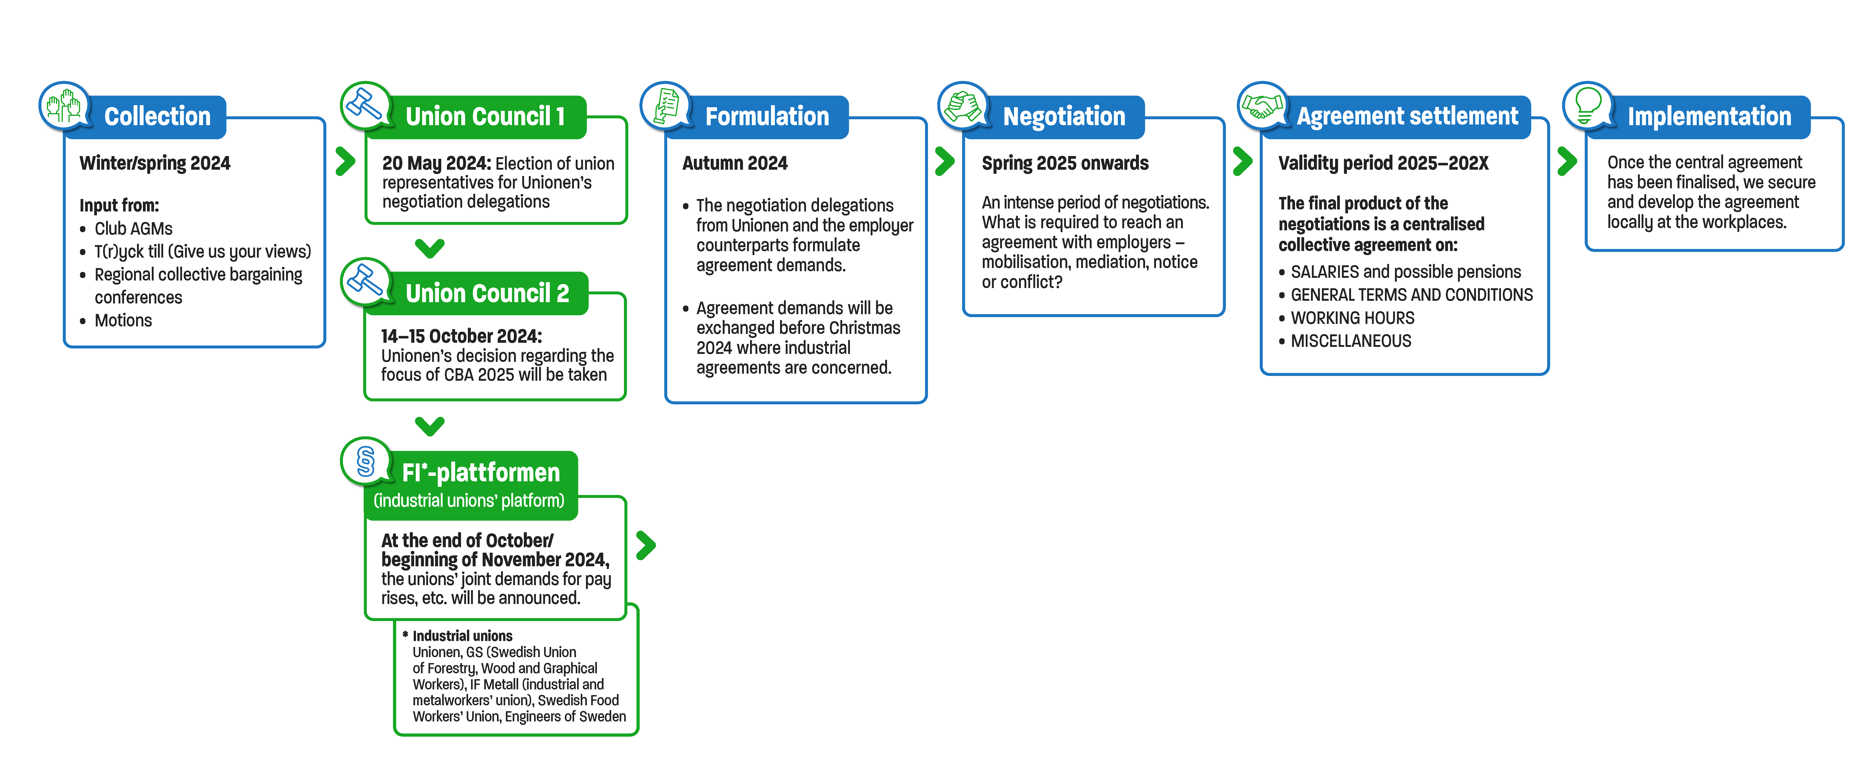
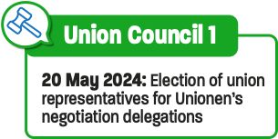
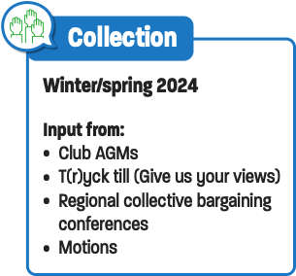
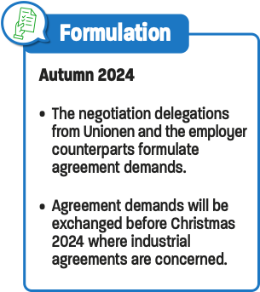
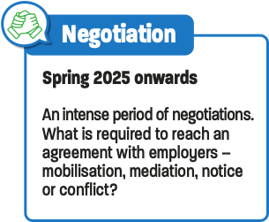
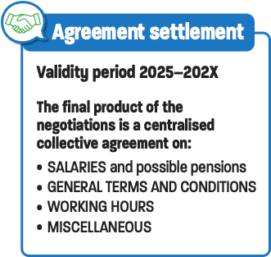
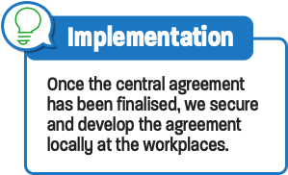
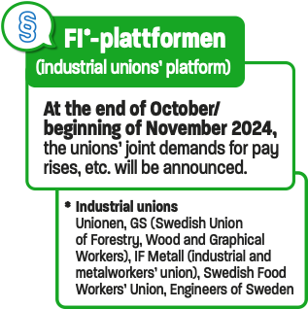
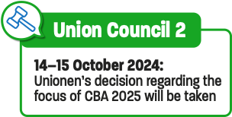
A collective bargaining process – step by step
How does it work? How can you and your local organisation make a difference?
And what happens next?
Notes:
This is an overview of the 2025 collective bargaining process. Information on what takes place in each phase of the process is shown in these boxes.
All elements are based on – and continuously cross-checked against – the long-term political platforms formulated by Unionen’s union representatives in different areas.
Unionen is meticulous in all elements – after all, there are many thousands of members who are usually covered by each central collective agreement that Unionen signs.
NB: This page is structured in steps, with the different phases appearing when you click on them. The animations will be displayed correctly when shown in presentation mode.

Slide 5
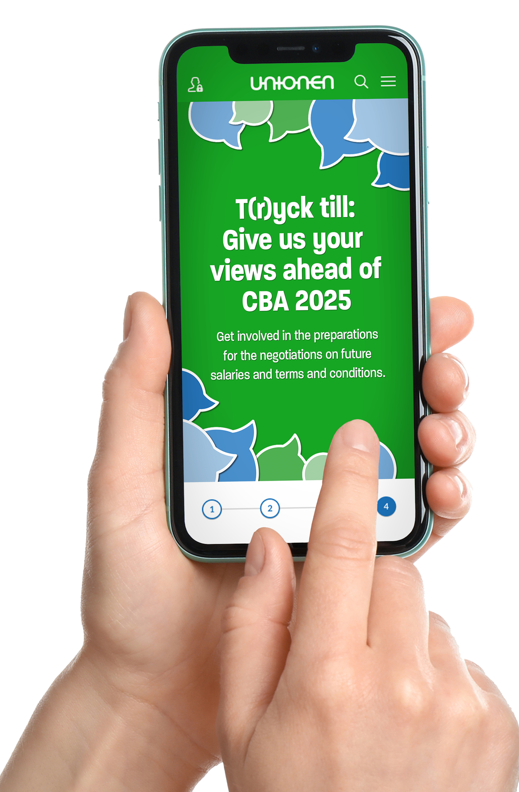

Get involved in the collective bargaining process!
Active AGM
Nominate candidates for the industry delegation that negotiates your agreement by 10 March at the latest, and elect representatives to the Regional Council that appoints union council representatives!
Attend the regional collective bargaining
conference in April
In-depth discussion on agreement issues with the Regional Board, agreement-negotiating ombudsman, etc.
Write motions
Make one or more concrete proposals for changes to the agreement. To be submitted by 14 August 2024.
T(r)yck till: Give your views about your
Unionen agreement
Survey open from the AGM until May.
Have an influence on what affects you!
Log in easily using BankID
or via unionen.se/avtal2025
Notes:
First phase – Collection phase
Here is some more detailed information on the phase we are currently in.

