Slide 1
Notes:
This page is to be displayed while members and participants take their seats. The title of the presentation is on the next page.

Slide 2
Towards a new collective agreement
Notes:
Welcome.
Today we will talk about the collective bargaining process and how it works when the terms of the collective agreement that applies at your workplace are negotiated.
Collective agreements that provide clear rules and conditions for everything from pay and working hours to work-life balance, holidays and pensions.
The important thing to remember is that it is members who decide which issues Unionen should pursue. Your commitment plays a role in ensuring that we achieve the best results in the negotiations.

Slide 3

Many agreements. Many possibilities.
Unionen negotiates 67 different agreements.
Your collective agreement is part of a larger whole.
This is where both broad demands and more specific issues take shape.
Notes:
In 2027, the collective agreement that applies to you will be negotiated. But that's not the only thing.
Unionen negotiates as many as 67 different agreements that apply to different industries. So it's a big and complex whole.
The agreements expire on various dates from 31 March to the end of December. Contract negotiations will thus continue throughout 2027.
Each agreement has its own specific challenges and priorities.
To do this well, there are sector negotiating committees, which develop the demands for each agreement area and base it on the members' experiences.
They then follow the negotiations and make sure that Unionen is pursuing the right issues.
In this way, Unionen ensures that the agreements reflect the reality in the members' workplaces.

Slide 4


Slide 5

What is the collective bargaining round?
Collective bargaining is when collective agreements are renegotiated.
The conditions at work – salary, working hours, balance in life,
holidays and pension – are shaped.
The members decide what demands Unionen pursues.
Notes:
The collective bargaining round is thus the period when collective agreements are renegotiated.
This is where the rules of the game at work are set: salary increases, working hours, flexibility, time off, pensions and much more.
The fact that we have collective agreements with clear rules and conditions is safe and good - for both employees and employers.
But in a collective bargaining round, we will try to agree on how the various rules and conditions should be designed. It is not always easy, employees and employers may have different interests that need to meet in order to reach a new agreement. It is therefore important that we come to the negotiations well prepared and that we know what is important to prioritise.
In the spring of 2026, the members have set their priorities and this will be the basis for the demands that Unionen presents. Unionen does not pursue issues they think are important, but issues the members say are important.

Slide 6
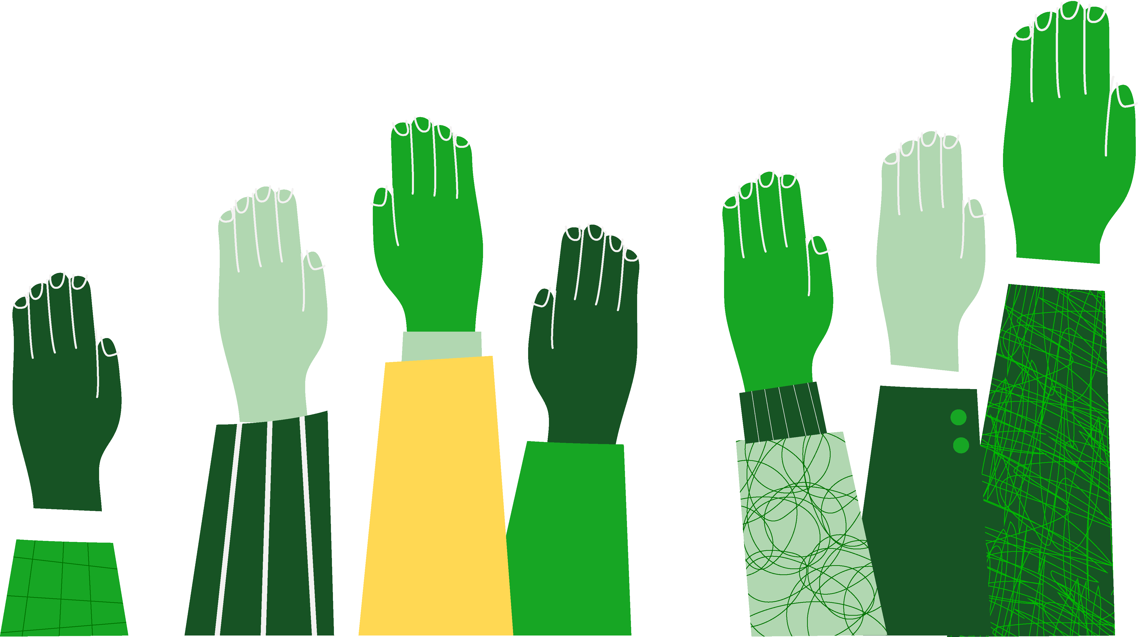
Sector negotiating committees – members' voice in the negotiations
Sector negotiating committees – Branschdelegationer
Develop demands for each agreement area.
Draw on members’ experiences and priorities.
Follow the negotiations and pursue Unionen’s position.
Ensure that the agreements reflect workplace realities.
Find your sector negotiating committee - unionen.se/rad-och-stod/branschdelegationer
Notes:
The sector negotiating committees are the members' voice throughout the negotiation process. Which people should be included in the sector negotiating committees has been proposed by members. Democratically elected by the Unionen National Council (förbundsråd) last spring. The members of the sector negotiating committees are elected representatives who work at different companies within the various agreement areas covered by the sector negotiating committee. They contribute with knowledge and experience about challenges and what can be good solutions for the industry they work in.
In total, there are 13 sector negotiating committees.
They develop demands for each area of agreement, based on the priorities that have been collected and proposals that have been presented in motions.
Their work, which is now starting, is a large and important part of the collective bargaining negotiations. They take responsibility for ensuring that the demands and proposals presented are adapted to the reality of your industry and workplace.
They follow the negotiations, pursue Unionen's line and make sure that they stand up for what has been promised.
And most importantly, they ensure that contracts truly reflect the reality of the workplace.
On Unionen's website, you can find your sector negotiating committee and see which people represent you in it.
unionen.se/rad-och-stod/branschdelegationer

Slide 7
Direction for collective bargaining negotiations
Members have told us what they want in the gathering phase in the spring of 2026
The focus sets out Unionen's priorities in the collective bargaining negotiations
The sector negotiating committees draw up demands for each agreement area
Ensuring a fair share of economic development
In addition to increased wages, the scope for collective bargaining can be used for other improvements
Notes:
During the spring of 2026, members have told us what they want through the Tyck till survey, regional agreement conferences and motions. This forms the basis for the direction of the collective bargaining negotiations that appointed members decided on at the Collective Bargaining Council in September 2026.
The focus sets out Unionen's priorities and is the starting point for the collective bargaining negotiations, which will begin in early 2027. The sector negotiating committees then formulate the concrete demands for the agreement area that you are covered by.
At the Unionen National Council in september (Avtalsförbundsrådet), the motions that had been submitted were also discussed by elected representatives. Many motions were sent on to the sector negotiating committees (branschdelegationer). On the basis of the motions and the decided direction, the committees will now formulate the demands for each of the 67 agreement areas that will be renegotiated in 2027.
The policy decision states that Unionen must secure a fair share of economic growth through collective bargaining and ensure that this share is used to improve terms and conditions of employment.
The scope for collective bargaining can be used for increased wages and other improvements, such as a reduction in working hours, provisions for flex-pension or other things that add value to members.

Slide 8
Unionen’s priorities CBA 2027
Annual salary reviews with a clearly defined total amount available for pay increases should provide the best possible real wage growth over time.
The minimum wages in the agreements will be raised at the same pace.
Union representatives will have insight into the salary structure and influence over salary setting in new hires and promotions.
Additional provisions for reduction in working hours/shorter working hours.
Notes:
Annual salary review and real wage growth over time
Everyone should have the right to an annual salary review and an agreement with a fixed total amount available for pay increases that guarantees salary development. The total amount available for pay increases should provide the best possible real wage growth over time, without being too low or too high. We will return to what this means when we go through The Mark (Märket) and how the model we have had since 1998 can continue to give Unionen's members real wage growth.
The minimum wages in the agreements must keep pace
We want to raise the minimum wages in the agreements at the same rate as other wages, so that those who have the lowest wage do not fall behind.
Transparency and influence over salary structure and salary setting
The salary in the event of new employment or promotion affects the salary development over a long period of time. Therefore, our union representatives need better tools for transparency in the salary structure and influence over salary setting. This gives them the opportunity to monitor and influence salary levels in order to avoid inappropriate pay differences and incorrectly set wages that are difficult to correct later.
Reduction in working hours/shorter working hours
Unionen's long-term goal is at least a 100-hour reduction in working hours on all agreements. In the last collective bargaining round, we took an important step and introduced a reduction in working hours in all areas of agreement. Now we want to build on with further reductions in working hours within the systems that exist.
The form and implementation must be stated in the demands for each agreement area. Your representatives in the sector negotiating committees contribute their knowledge and are responsible for ensuring that the demands and proposals suit your industry and workplace.

Slide 9
Unionen’s priorities CBA 2027
Increased gender equality through more parent-friendly conditions.
Trade union representatives will have better conditions to carry out their assignments
Provisions for flex-pension on the agreement that has not yet reached the target of 2%.
Need for adaptations that may arise based on legislation, case law from the European Court of Justice, or the Labour Court and/or on the basis of a longer working life.
Notes:
More parent-friendly
conditions More parent-friendly conditions are important to increase gender equality. It can also contribute to a more sustainable working life in the part of life where parenthood has a greater role.
Better conditions for union representatives
Trade union representatives play a major role in ensuring good conditions and the opportunity to influence the workplace for Unionen's members. It is therefore important that they are given good conditions to carry out their assignments and that they can feel safe.
flex-pension
In some agreement areas, we are not quite at the goal of the flex-pension and the 2% provision for occupational pension. In the areas that remain, it is a priority to achieve this. (6 collective agreement areas remain)
Need for adaptations based on changes in legislation or practice
If there is a need to make adjustments to collective agreements caused bychanges in legislation, practice from the European Court of Justice, or the Labour Court and/or based on a longer working life, it may be a priority to pursue demands in the contract negotiation linked to such changes. From the time the policy decision was made until we hand over the first demands in December, there may be changes that need to be captured, and it is therefore important that it is included as a priority before the collective bargaining negotiations.

Slide 10
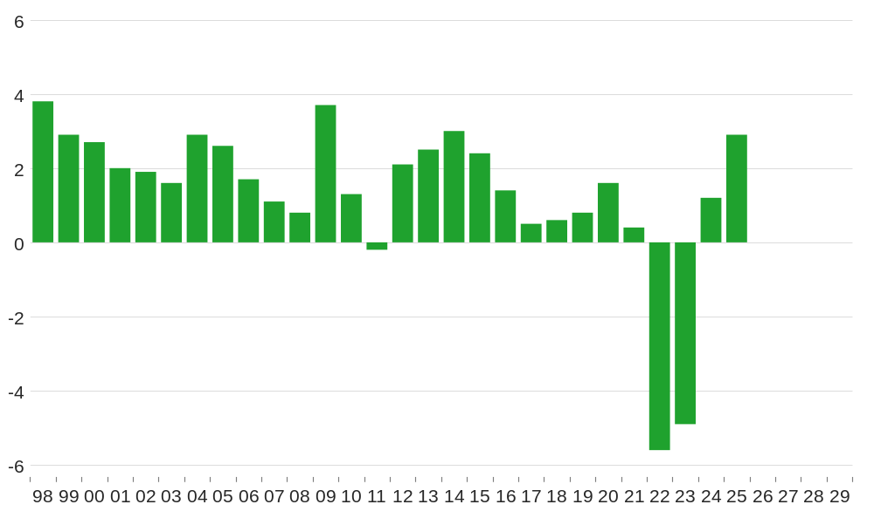
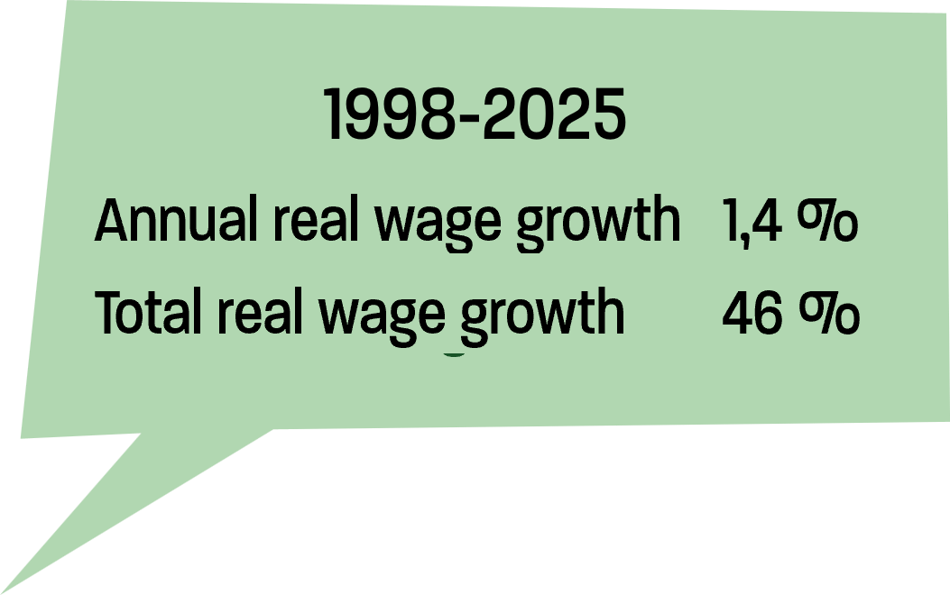
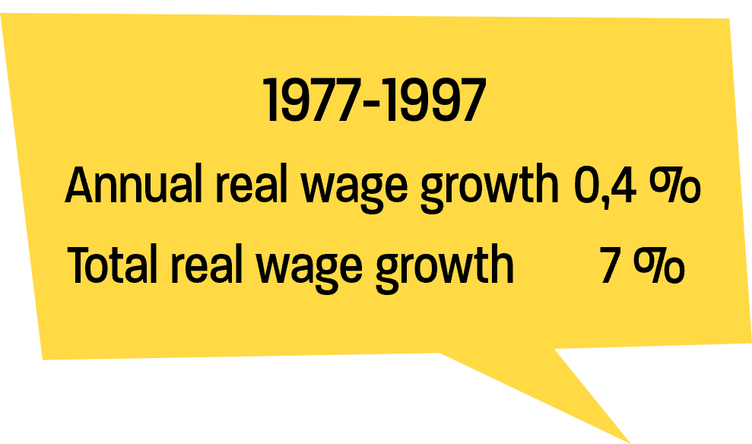
Best possible!
Real wage growth with the Industry Agreement and “The Mark” over time
Notes:
Best possible!
The best possible real wage growth is something we have focused on since the Industry Agreement was introduced in the late 90s. A focus that, when we look in the rear-view mirror, has given a good result for Unionen's members.
Real wage increases
What level of salary increases should we have? Why does the Union not always ask for much more? It is about finding the best possible level, because a reasonable level can deliver the most over time.
As we mentioned before, since the model with The Mark, Märket, was introduced, we have had a good real wage growth in Sweden.
The period before The Mark was characterised by the fact that there was no norm or benchmark for wage setting in the Swedish labour market. Different groups of employees negotiated separately. All competed with each other to get a higher percentage than the others. This caused costs for companies to rise, thus creating a rampant wage-price spiral in which inflation rose sharply and simply ate up the high wage increases. This was bad for the employees, for the companies and for society. Despite high percentage wage increases, real wage growth during the 20-year period before The Mark was only a total of 7%, or an average of 0.4% per year.
It can be easy to think that there is always too little, but the truth is that since 1997, when the wage formation model we have today was introduced and until 2021, we have had a real wage increase of about 55%. Exceptionally high inflation caused a drop in the agreement years 2022 and 2023, we have had a total real wage increase of 46% from 1998 to 2025. As it looks now, we will have recovered from the large loss that occurred in 2022-2023 sometime in 2027. An important explanation for the good result is that we end up at the right level – is precisely the model with The Mark.
So at least in this case, we know that just enough is actually the most! And the best!

Slide 11
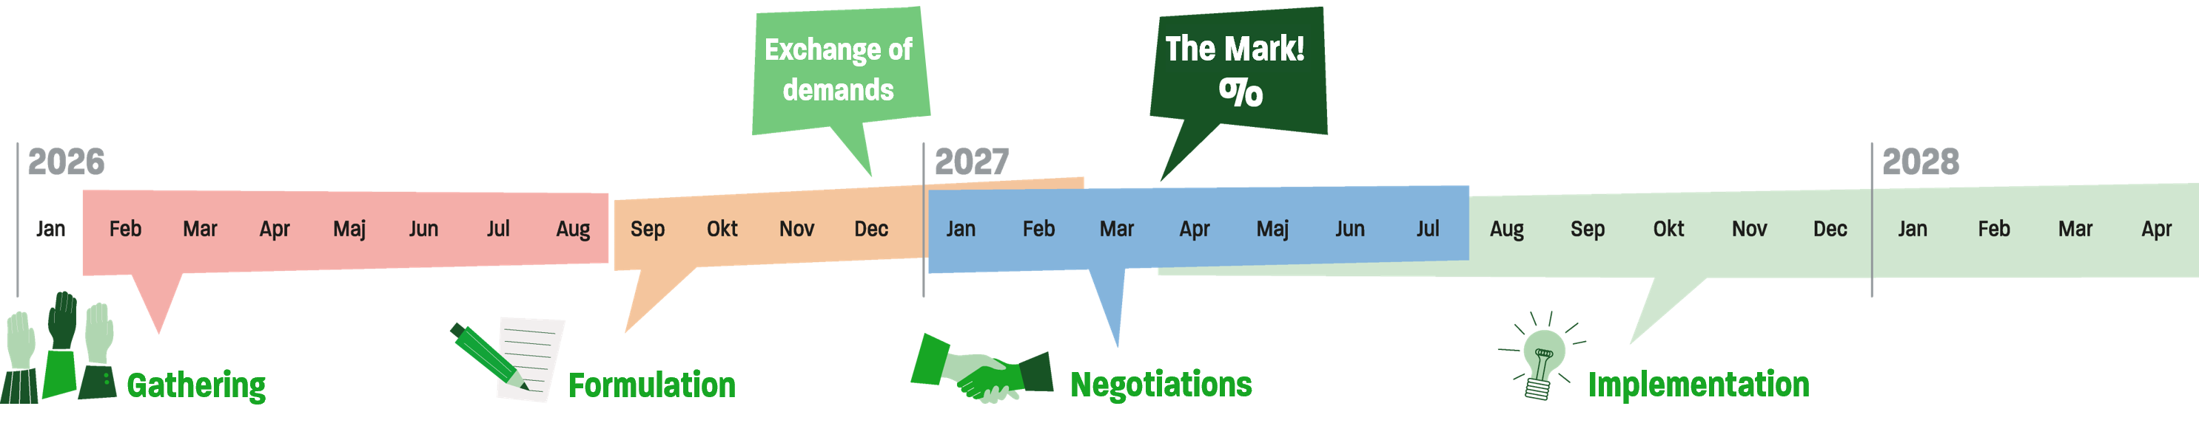
The path to CBA 2027
October/November 2026: The sector negotiating committees formulate demands for each agreement area.
November 2026: The unions in industry present their common platform and their overall demands.
December 2026: Unions and employers within the industrial sector exchange demands.
January to March 2027: Negotiations within the industrial sector.
January to December 2027: Exexchange of demands and negotiations in Unionen's other areas of agreement.
31 March 2027: The collective agreements within the industrial sector expires. The goal is for new agreements to be ready and specify the level of wage increases in the rest of the labour market.
December 2027: The last of Unionen's 67 agreement areas expires and is expected to receive a new collective agreement.
Notes:
Between now and the finalisation of a new agreement, we have some important points of reference
October/November 2026: The sector negotiating committees formulate demands for each agreement area.
November 2026 The Swedish unions within Industry’s (facken inom industrin) common platform are presented and we get a figure on the total amount available for pay increases required from the union side in the collective bargaining process.
In the model we have with the industry setting The Mark, the demands presented by the 5 trade unions that perform under the name The Swedish unions within Industry, Unionen, the Engineers of Sweden (Sveriges Ingenjörer), IF-Metall, the Swedish Union of Forestry, Wood, and Graphical Workers (GS-facket) and the Swedish Food Workers’ Union (Livs), have become an important event in the collective bargaining round.
The number of the total amount available for pay increases, and other improvements, and the length of the agreement period is what constitutes The Mark. Other common demands put forward by The Swedish unions within Industry are not part of The Mark. But it gives us strength in the negotiations when we help each other and can back each other's most important issues. One clear such issue during the last round of collective bargaining was the reduction of working hours, which, thanks to a concerted effort, we managed to get through in all areas of Unionen's collective bargaining agreement.
December 2026: Unions and employers within the industrial sector exchange demands.
Specific demands for each of Unionen's 12 industrial agreements are now being handed over to employers. In the same way, we receive the demands from the employers' side. It usually happens sometime just before Christmas
2027
January to March 2027: Negotiations within the industrial sector.
January to December 2027: Exchanges of demands and negotiations in Unionen's other agreement areas are carried out continuously during the year in relation to when the various agreements expire. Non-manufacturing agreements expiring on 31 March will be finalised at the beginning of April.
THE NAME OF THE AGREEMENT that applies to you expires on XX MONTH
31 March 2027: The collective agreements within the industrial sector expires. The goal is for new agreements to be ready and specify the level of wage increases in the rest of the labour market.
January – November – Exchange of demands takes place on an ongoing basis in relation to when in the year the agreements expire.
December 2027: The last of Unionen's 67 agreement areas expires and is expected to receive a new collective agreement

Slide 12
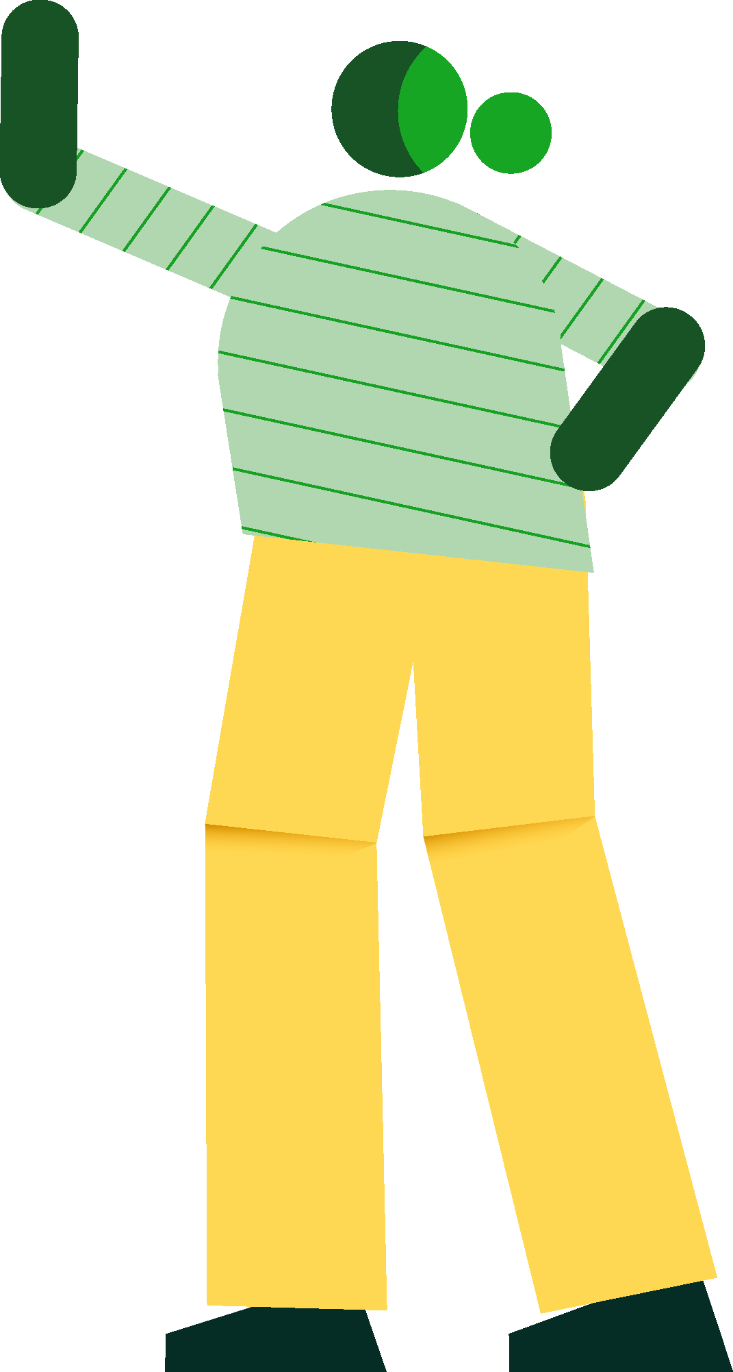
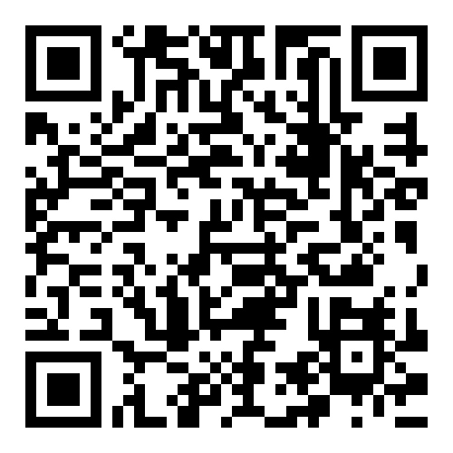
Join us and learn more!
Together we make a difference. With your help, we shape strong agreements that improve working life!
Get involved for better conditions today!
Visit Avtal2027 for the latest news, your sector negotiating committee and support to get you and other members involved in the collective bargaining process.
Join the movement
for a better working life!
Notes:
Finally, we would like to emphasise once again that your and all other members' commitment matters.
It is together that we create strong agreements that change the world of work.
On the Unionen.se/avtal2027 – page – you will find the latest news in the collective bargaining round. From there, you can also find your sector negotiating committee, learn more about the importance of collective agreements and find inspiration and other things that can help you in your commitment and to engage other members in the collective bargaining movement.
So go in and be inspired to continue to engage yourself and others to influence for a better working life.
Thank you!

